Slide 1
OKORIE BRIDGET AKUNNA CORP MEMBER EKITI STATE BATCH C, STREAM II EK/24C/2617 AIM INFOSYS CAPSTONE PROJECT THEME: CLIMATE CHANGE AND SOCIAL CONFLICTS – TO UNDERSTAND CONFLICT AND SOCIETIES AND FOSTER PEACE. TOPIC: IMPACT OF DROUGHT AND WILDFIRES ON SOCIAL CONFLICTS IN AFRICA: A DATA-DRIVEN ANALYSIS

Slide 2
TABLE OF CONTENTS
Introduction
Justification of the study
Objectives
Methodology
Result discussion
Conclusion and recommendation

Slide 3
INTRODUCTION
Climate change has become a pressing issue globally for communities, organizations, and countries.
Natural resource scarcity has led to geopolitical disputes between governments and regions, as many resources, such as oil, gas, minerals, and water, are essential to economic growth, national security, and livelihood.
According to Mackay et al. (2024), natural disaster can be regarded as a traumatic experience, especially in developing regions such as those in many places across Africa where they lead to economic vulnerabilities, difficulty in accessing resources and poorly perceived institutional performance.
Vulnerable communities disproportionately affected by climate change experience heightened inequalities, and foster conditions ripe for unrest and conflicts.

Slide 4
Justification Of The Study
This study is justified because it addresses a critical knowledge gap on the relationships between climate – induced disasters (droughts and wildfires) and social conflicts in Africa, providing valuable insights for policymakers and stakeholders to develop effective strategies for conflict mitigation and peace-building in the face of climate change.

Slide 5
Objectives of the Study
To investigate the relationship between droughts, wildfire and social conflicts in Africa.
To identify the most vulnerable regions and communities to climate–induced disasters and conflicts.
To analyze the impact of climate change on social stability and conflict dynamics.
To provide insights for policymakers and stakeholders to develop effective strategies for conflict mitigation and peace-building.

Slide 6
Methodology
Source of the Datasets: The dataset was downloaded from the EMDAT site (https://www.emdat.be/). It is a site that holds datasets on natural disasters.
Package or Software used for the Analysis: The software used is python jupyter notebook embedded in anaconda.
Data Cleaning: The dataset that was downloaded from the EMDAT site was saved in a folder called python scripts. That way, the jupyter notebook in anaconda would be able to read it.
Firstly, I imported the libraries which are numpy and pandas as np and pd respectively. These made the dataset to be displayed in array (dataframe).
Being that the dataset is in excel sheet, it was read as df = pd.read_excel(('public_emdat_custom_request_2025-05-13_5a50590e-487c-47ce-bd16-cc79e0784121.xlsx').

Slide 7
df.head() displayed the first five(5) rows with the columns. df.shape showed the number of rows and columns that are contained in the dataset.
I checked for the columns that are empty and the ones that are not up to 30 – 50% filled and dropped them using the code; df= df.dropna(axis='columns', how='all').
For the very important columns are can not be dropped, I filled them up the zeros.
All the unique columns that could not be dropped using df= df.dropna were removed by using indexing, e.g; column_number_to_remove = [19, 34, 35, 36, 37, 38, 39]
df.drop(df.columns[column_number_to_remove], axis = 1, inplace = True).
The second dataset was imported as read as excel file; df2 = pd.read_excel('JME_Regional-Classifications.xlsx').

Slide 8
After it was cleaned, it was merged with the initial dataset; df1 = pd.merge(left=df, right=df2, left_on = 'ISO', right_on = 'ISO Code', how = 'left'), df1 = df1.drop(columns = 'ISO Code').
The % of the ‘Total Affected’ per Subregion was calculated using; count_by_subregion['Percentage'] = (count_by_subregion['Total Affected']/sum(count_by_subregion['Total Affected']))*100.
The % of the ‘Total Affected’ per Country was also calculated using the codes; count_by_country = df.groupby('Country').sum().sort_values(by= 'Total Affected', ascending=False).reset_index()
count_by_country['Percentage of Total Affected']= count_by_country['Total Affected']/sum(count_by_country['Total Affected']).
The libraries such as plotly.express, matplotlib.pyplot and seaborn for plotting of charts were imported as px, plt and sns respectively.

Slide 9
A donut and pie chart were plotted which showed the percentage and number of persons affected per UN Subregion, where different colours represents the Subregions.
A map chart was also used to show the subregions in Africa that were affected.
A scatter plot was used to show the % of total affected per country.
A multivariate bar chart was plotted which displayed countries with their disaster subtype and their income level.
A scatter_plot chart was used to visualize the CPI of different countries, where colour was used for each of the country’s identity.

Slide 10
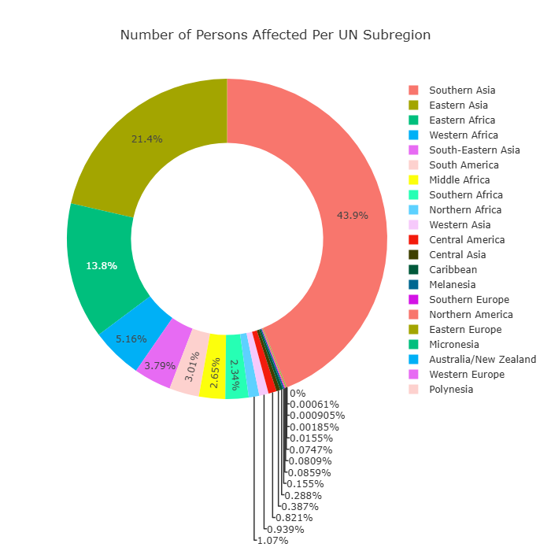
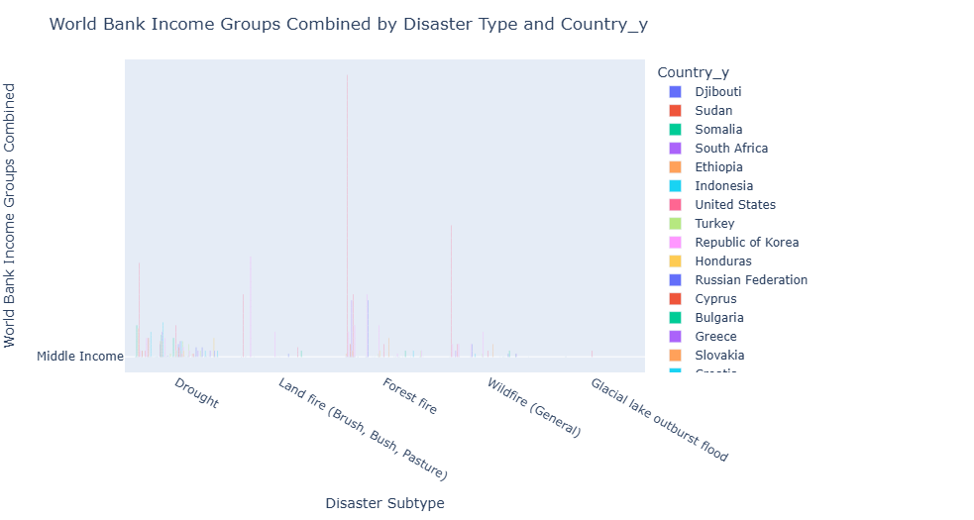
Donut and Bar Chart
(a)

Slide 11
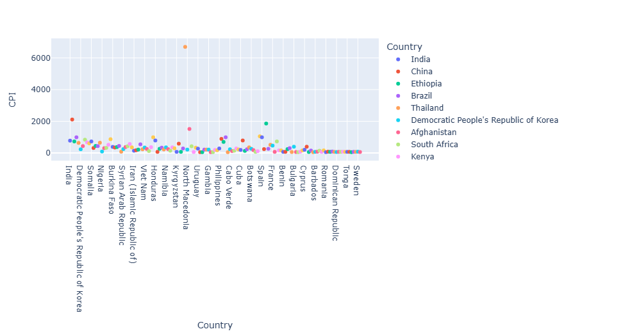
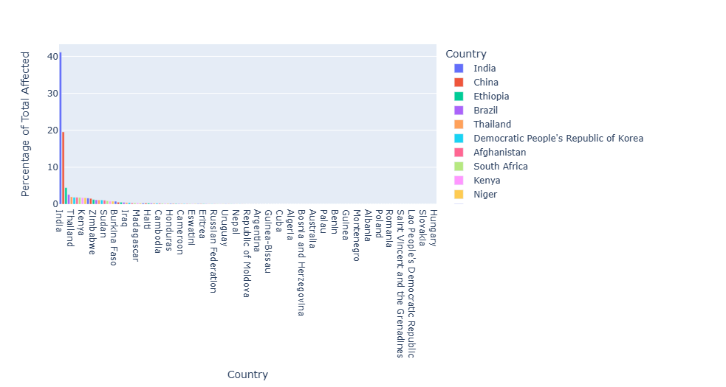
A Scatter_plot and Bar Chart

Slide 12
Result Discussion
Highest affected African subregion – Eastern African (13.8%), 230,551,996 people affected.
Western Africa (5.16%) is the second most affected African subregion, with 86,400,127 people affected.
Least affected African subregion is the Northern Africa (1.07%) with the total number of people affected to be 17,921,597.
The most affected African country is Ethopia, which has the % of total affected to be 4.462700%.
The % of total affected in Nigeria is 1.141617%.
The least affected country in Africa is Gambia, which has 0.02933734% of total affected.
Being that most African countries are undeveloped, there are classified as low-income countries.

Slide 13
Conclusion
The variation in the impact of droughts and wildfires on social conflict across African subregions reflects complex interplays of climate, livelihoods, governance and vulnerability.
While Eastern Africa bears the highest burden due to its ecological fragility and socio-political context, comprehensive, region-specific strategies rooted in resilience, governance and sustainable development can reduce these risks significantly.

Slide 14
Recommendations
Climate-Resilient Infrastructure: Invest in climate-resilient infrastructure, such as water management systems and early warning systems, to mitigate the impacts of droughts and wildfires.
Data-Driven Decision Making: Leverage data analysis and monitoring to inform decision making and response strategies, enabling more effective and targeted interventions.
Peace-building and Conflict Resolution: Integrate peace-building and conflict resolution strategies into climate change adaptation and disaster risk reduction efforts, promoting sustainable peace and stability in vulnerable regions.

Slide 15
THANK YOU FOR LISTENING

